Slide 1

  Chapter Three
  The Network Layer

Slide 2
Outline
  Internetworking,
  Network layer protocols
  IPV4 Addressing [Class full]
  IPV4 Addressing [ Classless- VLSM addressing]
  Introducing IPV6 Addressing
  Unicast and multicast routing

Slide 3
Network Layer (3rd OSI Layer)
Concerned with getting packets from source to destination.
The network layer must know the topology of the subnet and choose appropriate paths through it.
When source and destination are in different networks, the network layer must deal with these differences.
The network layer is responsible for the source-to-destination delivery of a packet, possibly across multiple networks.
Whereas. the data link layer oversees the delivery of the packet between two systems on the same network.
If two systems are connected to the same local network, there is usually no need for a network layer.
However, if the two systems are attached to different networks with connecting devices between the networks, there is often a need for the network layer to accomplish source-to-destination delivery.

Slide 4
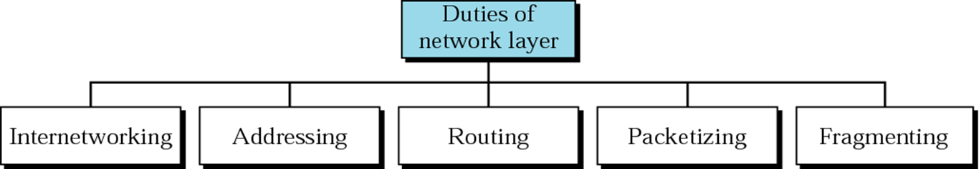

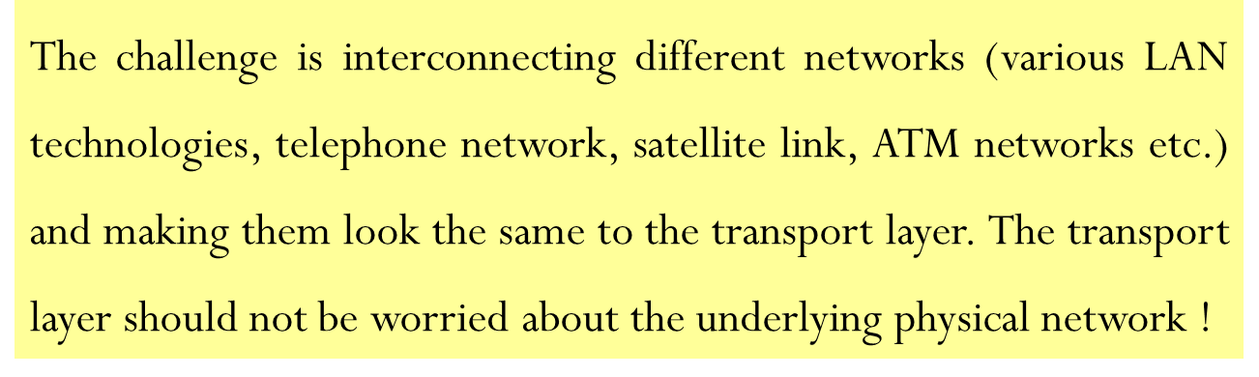
Cntd…

Slide 5
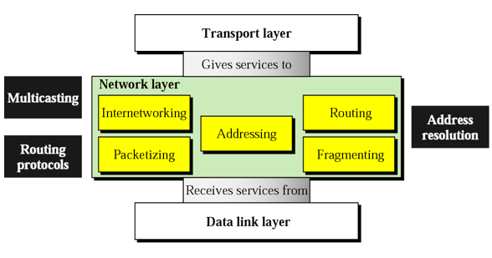
Position of network layer

Slide 6
Network Layer Protocols
  IPv4 wasn’t designed with this feature in mind, although mobility extensions exist.
  IPv6 has a better designed solution.
  Network layer protocols include:
    IPv4/IPv6, DVMRP (Distance Vector Multicast Routing Protocol),
    ICMP(Internet Control Message Protocol),
    IGMP(Internet Group Multicast Protocol),
    PIM-SM( Protocol Independent Multicast Sparse Mode),
    PIM-DM(Protocol Independent Multicast Dense Mode),
    IPsec(Internet Protocol Security),
    IPX(Internetwork Packet Exchange),
    RIP(Routing Information Protocol),
    Interior Gateway routing protocol(IGRP),
    Enhanced IGRP(EIGRP),
    Open Shortest Path First(OSPF),
    DDP(Datagram Delivery Protocol),
    BGP(Border Gateway Protocol), etc

Slide 7
Routing Basics
The network layer of the OSI model provides routing functions and establishes the route between the source and destination through intermediary nodes(routers).
Routing is one of the fundamental aspects of networking.
The ability of routers to learn possible routes is one of the primary reasons that ARPANET which originally connected seven sites, scaled into the modern Internet in only a few short years.
A router connects at least two networks and forwards data packets from one to another node.
When it receives an incoming packet, it decides the next router (hop) to which the packet should be forwarded towards its destination.
A routing protocol allows routers to share information about networks and their proximity to each other.
A routing table maintains the best routes to various network destinations.
Routed networks are often large and complex, and it would be excessively difficult to manage and update network information on all routers all the time.
Several algorithms have been developed to help address these difficulties.

Slide 8
Popular Routing Protocols
  A routing protocol is a protocol that specifies how routers communicate with each other.
  It disseminates information that enables them to select routes between any two nodes on a computer network
  The choice of the route being done by routing algorithms.
  Each router has a priori knowledge only of networks attached to it directly.
  A routing protocol shares this information first among immediate neighbors, and then throughout the network.
    This way, routers gain knowledge of the topology of the network.
  The term routing protocol may refer specifically to one operating at layer three of the OSI model, which similarly disseminates topology information between routers.

Slide 9
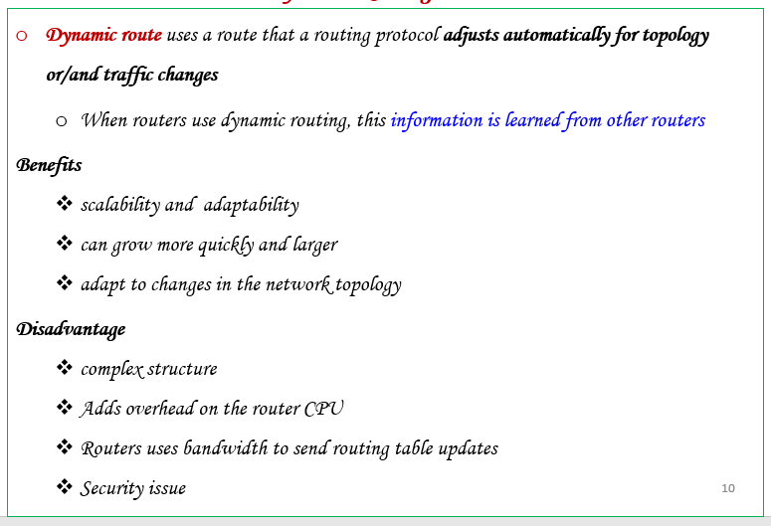
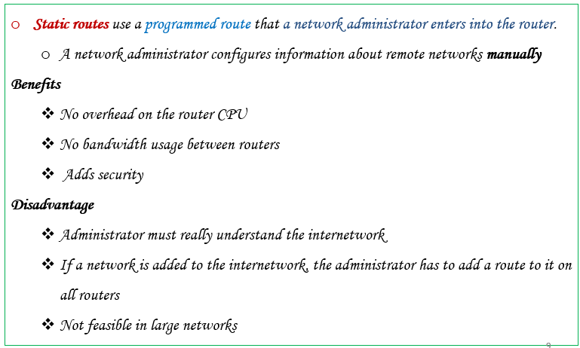
Which Router/ Routing to Use?
Routers will use either static or dynamic routing techniques.
static routing, network administrators must manually create and modify the routing table entries.
Dynamic routing uses a specialized routing protocol to update the table entries automatically.

Slide 10
Overview of Internet Routing
The Internet includes a large number of interconnected heterogeneous routing domains called autonomous systems (AS).
AS is essentially a collection of IP networks and routers under the same administration that share a common routing strategy.
  An Internet service provider (ISP) is the typical example of an AS.
For the outside world, an AS is regarded as a single routing entity.
Each AS must have a 16-bit AS number, which is unique and assigned by a regional Internet registry.
E.g. such as the American Registry of Internet Numbers (http://www.arin.net).
Some routing protocols require the AS number to make routing decisions.

Slide 11
Interior Vs Exterior Routing Protocols
The routing protocols used within an AS are called interior gateway protocols (IGPs), and the ones used between ASs are called exterior gateway protocols (EGPs).
Their main difference is that IGPs provide information on reachable interior destinations to the outside work, whereas, inversely, EGPs provide information on reachable exterior destinations to the interior routers.
EGPs are typically used between internet service providers (ISPs).
Another difference between them is the route determination.
IGPs choose the best path through the network based on some metrics such as distance, delay, or bandwidth.
Therefore, how the metrics are used is an important design issue for IGPs.
EGPs choose routes commonly according to a routing policy.

Slide 12
Difference between IGP & EGP
IGP (Interior Gateway Protocol) :-
  Within a single autonomous system
  Single network administration
  Unique routing policy
  Make best use of network resource
IGP’s fall into two categories:
  Distance Vector Protocols
      Routing Information Protocol (RIP V_{1,} RIP V_{2 and} RIP_{ng})
      Interior Gateway Routing Protocol (IGRP)
      Enhanced Interior Gateway Routing Protocol (EIGRP)
  Link State Protocols
      Open Shortest Path First (OSPF)
      Intermediate System to Intermediate System (IS-IS)

Slide 13
Cntd…
EGP (Exterior Gateway Protocol ) :-
Among different autonomous systems
Independent administrative entities.
Communication between independent network infrastructures
EGP is commonly used between hosts on the Internet to exchange routing table information.
Examples of an EGP:
  Border Gateway Protocol (BGP)
  Exterior Gateway Protocol (Replaced by BGP)

Slide 14
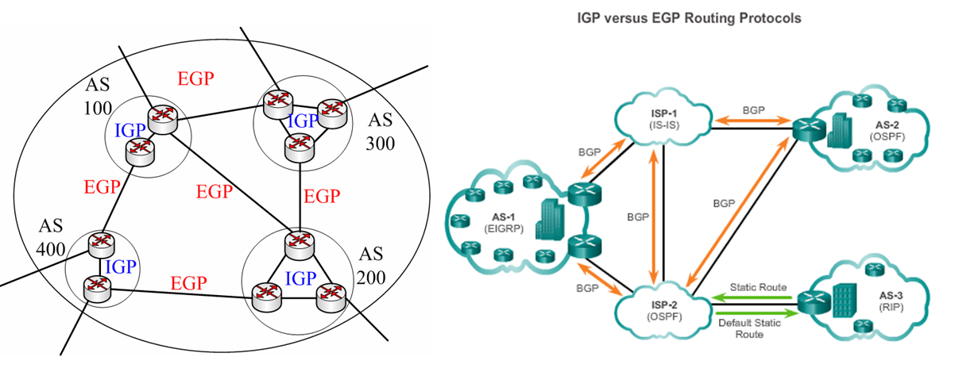
Cntd…
Fig The Internet includes a large number of autonomous systems

Slide 15
Classful Vs Classless Routing Protocols
I. Classful routing protocols don’t include the subnet mask with the route advertisement.
Within the same network, consistency of the subnet masks is assumed.
Summary routes are exchanged between foreign networks.
  E.g., of classful routing protocols: RIP V1, IGRP
  II. Classless routing protocols include the subnet mask with the route advertisement.
  Classless routing protocols support variable-length subnet masking (VLSM) and subnetting.
  E.g., of classless routing protocols: RIP V2, EIGRP, OSPF, IS-IS

Slide 16
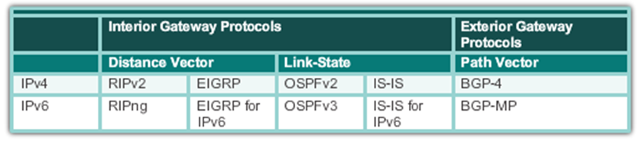
Classifications of Routing Protocols
Different routing protocols use different algorithms and approaches to gather and disseminate routing information about their area.
Routing protocols are classified into the following categories:

Slide 17
Distance Vector Vs. Link State Routing Protocols
A. Distance Vector
Updates frequently
Each router is "aware" of only its immediate neighbors
Slow convergence
Prone to routing loops
Easy to configure
Fewer router resources required
Updates require more bandwidth
Doesn’t "understand" the topology of the network
B. Link State
Updates are event triggered
Each router is "aware" of all other routers in the "area"
Fast convergence
Less subject to routing loops
More difficult to configure
More router resource intensive
Updates require less bandwidth
Has detailed knowledge of distant networks and routers

Slide 18
Cntd…
Path Vector Routing Protocol
  Idea:- The main characteristic of path vector protocols is a path of AS numbers between the source and destination (AS path) is maintained to detect loops.
  Are a class of distance vector protocols -> They also have no knowledge about instant routers and how they interconnect in the network.
  It uses the Bellman-Ford algorithm when there is more than one path available to a destination.
  The operation is similar to that of distance vector protocols.
  Each router advertises its local BGP routing table to its neighbors.
  As routers relay the advertisements, they add new routes to their own local routing table based on the contents of the advertisement.
  Besides, they add their own AS number to the AS path before sending out the advertisement.

Slide 19
Routing with Routing Information Protocol (RIP)
  RIP is a simple and true distance vector routing protocol, and the basic idea is that each router advertises the next hop and hop count for each destination it can reach to its directly connected neighbors.
    It sends the complete routing table out to all active interfaces every 30 seconds.
    RIP prevents routing loops by implementing a limit on the number of hops allowed in a path from the source to a destination.
    The maximum (distance) number of hops allowed for RIP is 15.
    Uses Bellman-ford algorithm
    Works well in small networks, but it’s inefficient on large networks.

Slide 20
Cntd…
    RIP comes with three versions:
      RIP version 1 uses only classful routing, which means that all devices in the network must use the same subnet mask
      RIP version 2 does send subnet mask information with the route updates. This is called classless routing.
      RIP next generation: is the newest version of RIP, designed to support IPv6.

Slide 21
Routing with Open Shortest Path First (OSPF)
  The OSPF protocol is a link-state routing protocol.
  Unlike RIP, each router within the network has a clear picture of the network topology.
  OSPF is an open standards routing protocol
  This works by using the Dijkstra algorithm (SPF)
  OSPF provides the following features:
    Minimizes routing update traffic
    Allows scalability (e.g. RIP is limited to 15 hops and Has unlimited hop count)
    It allows a multi-level routing hierarchy called area routing.
    Supports VLSM/CIDR(Classless Inter-Domain Routing )
    Allows multi-vendor deployment (open standard)
    Uses more complex route selection metrics.

Slide 22
Pros and Cons
  OSPF is a more sophisticated routing protocol
    Converges rapidly and accurately
    Can use a metric calculation that effectively selects the "best" route(s) primarily based on bandwidth,
    although an OSPF cost can be administratively assigned
  Use of OSPF requires
    More powerful routing hardware
    More detailed knowledge by the administrator, especially when large multi-area networks are used

Slide 23
Internet Protocol (IP)
  IP is a protocol used for communicating data across a packet-switched internetwork using the IP suite, also referred to as TCP/IP.
  IP is the primary protocol in the Internet Layer of the IP Suite and has the task of delivering datagrams (packets) from the source host to the destination host based on their addresses.
  For this purpose the IP defines addressing methods and structures for datagram encapsulation.
  The first major version of addressing structure, now referred to as IP Version 4 (IPv4) is still the dominant protocol of the Internet, although the successor, IP Version 6 (IPv6), is being deployed actively worldwide (128 bits).

Slide 24
IPv4 Addresses
  An IPv4 address is a 32-bit address.
  It uniquely and universally defines the connection of a device to the Internet.
  IPv4 addresses are unique and universal.
  They are unique in the sense that each address defines one, and only one, connection to the Internet.
  Two devices on the Internet can never have the same address at the same time.

Slide 25
Address Space
  An address space is the total number of addresses used by the protocol.
  If a protocol uses N bits to define an address, the address space is 2^{N} because each bit can have two different values (0 or 1) and N bits can have 2^{N} values.
  IPv4 uses 32-bit addresses, which means that the address space is 2³² or 4,294,967,296 (more than 4 billion).
  This means that, theoretically if there were no restrictions, more than 4 billion devices could be connected to the Internet.
  The actual number is much less because of the restrictions imposed on the addresses.

Slide 26
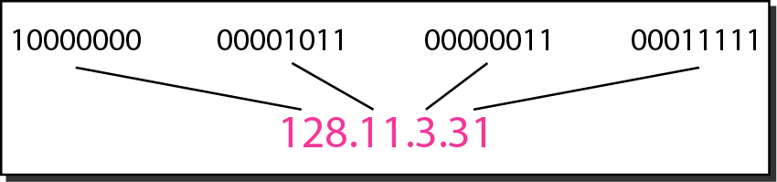
Notation
There are two predominant notations to show an 1Pv4 address: binary notation and dotted-decimal notation.
Binary Notation: In binary notation, the IPv4 address is displayed as 32 bits.
The following is an example of an IPv4 address in binary notation: 01110101 10010101 00011101 00000010
Dotted-Decimal Notation : To make the IPv4 address more compact and easier to read, Internet addresses are usually written in decimal form with a decimal point (dot) separating the bytes.
The following is the dotted-decimal notation of the above address: 117.149.29.2
Dotted-decimal notation and binary notation for an IPv4 address

Slide 27
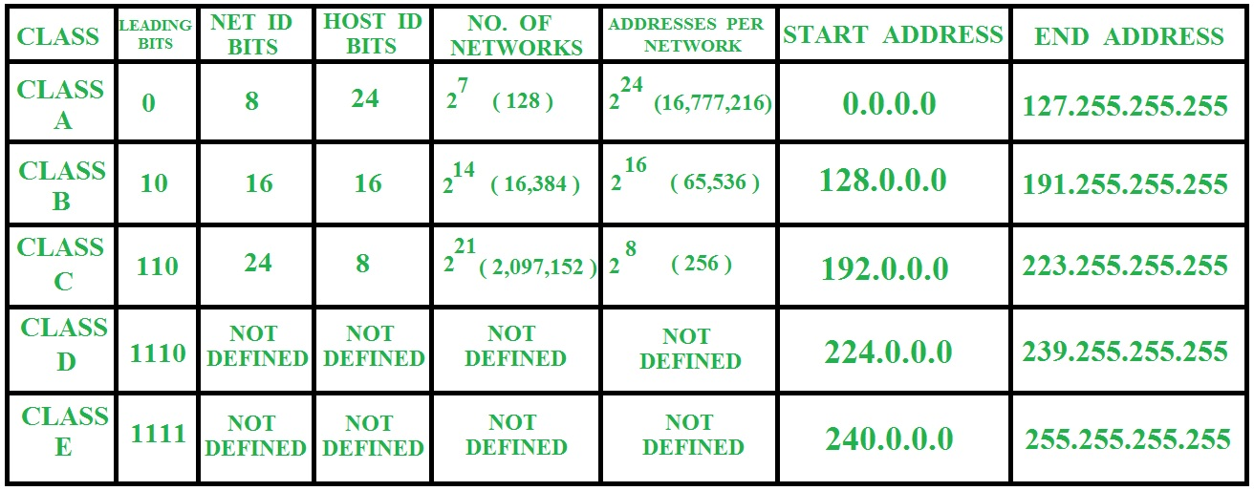
Classful Addressing
IPv4 addressing, used the concept of classes.
This architecture is called classful addressing.
In classful addressing, the address space is divided into five classes: A, B, C, D, and E. Each class occupies some part of the address space.

Slide 28
Example
Find the class of the following IP addresses.
  00000001 00001011 00001011 11101111
  11000001 10000011 00011011 11111111
  14.23.120.8
  252.5.15.111
Solution
  The first bit is 0. This is a class-A address.
  The first 2 bits are 1; the third bit is 0. This is a class C address.
  The first byte is 14; the class is A.
  The first byte is 252; the class is E.

Slide 29
Classes and Blocks
One problem with classful addressing is that each class is divided into a fixed number of blocks with each block having a fixed size
Number of Blocks for class A = 2⁷
Number of Blocks for class B = 2¹⁴
Number of Blocks for class C = 2²¹
Block size for class A = 2²⁴
Block size for class B = 2¹⁶
Block size for class C = 2⁸

Slide 30
Cntd…
Previously, when an organization requested a block of addresses, it was granted one in class A, B, or C.
Class A addresses were designed for only large organizations such as the military, government agencies, universities, and large corporations with a large number of attached hosts or routers.
  A block in class A address is too large for almost any organization.
  This means most of the addresses in class A were wasted and were not used.
Class B addresses were designed for midsize organizations with tens of thousands of attached hosts or routers.
  A block in class B is also very large, probably too large for many of the organizations that received a class B block.
Class C addresses were designed for small organizations with a small number of attached hosts or routers.
  A block in class C is probably too small for many organizations.

Slide 31
Network ID and Host ID
In classful addressing, an IP address in class A, B, or C is divided into network ID and host ID.
These parts are of varying lengths, depending on the class of the address.
In class A, 1 byte defines the network ID & 3 bytes define the host ID.
In class B, 2 bytes define the network ID & 2 bytes define the host ID.
In class C, 3 bytes define the network ID & 1 byte defines the host ID.
1st octet
2nd octet
3rd octet
4th octet
Class A
Network
Host
Host
Host
Network
Network
Host
Host
Class C
Network
Network
Network
Host

Slide 32
Default Mask
The length of the network ID and host ID (in bits) is predetermined in classful addressing,
We can also use a mask (also called the default mask), a 32-bit number made of contiguous 1s followed by contiguous 0s.
The mask can help us to find the network ID and the host ID.
For example, the mask for a class A address has eight 1s, which means the first 8 bits of any address in class A define the network ID; the next 24 bits define the host ID.

Slide 33
IP address shortage
In the early days of the Internet, IP addresses were allocated to organizations based on request rather than actual need.
The flaws in classful addressing scheme combined with the fast growth of the Internet led to the near depletion of the available addresses.
Yet the number of devices on the Internet is much less than the 2³² address space.
We have run out of class A and B addresses, and a class C block is too small for most midsize organizations.
One solution that has alleviated the problem is the idea of classless addressing.
No medium size - Hosts:
  Class A: 16 million
  Class B: 65,536
  Class C: 256

Slide 34
Subnetting
During the era of classful addressing, subnetting was introduced.
The solution to the IP address shortage was thought to be the subnet mask.
Formalized in 1985, the subnet mask breaks a single class A, B or C network in to smaller pieces.
If an organization was granted a large block in class A or B, it could divide the addresses into several contiguous groups and assign each group to smaller networks (called subnets).
Subnetting increases the number of 1s in the mask.
Subnetting is the process of borrowing bits from the HOST bits, in order to divide the larger network into small subnets.
Subnetting does NOT give you more hosts, but actually costs you hosts.

Slide 35
Cntd…
You lose two host IP Addresses for each subnet, and perhaps one for the subnet IP address and one for the subnet broadcast IP address.
You lose the last subnet and all of its hosts’ IP addresses as the broadcast for that subnet is the same as the broadcast for the network.
In older networks, you would have lost the first subnet, as the subnet IP address is the same as the network IP address. (This subnet can be used in most networks.)
Network
Network
Host
Host
172
16
0
0
Network
Network
Subnet
Host

Slide 36
Classless Addressing
To overcome address depletion and give more organizations access to the Internet, classless addressing was designed and implemented.
In this scheme, there are no classes, but the addresses are still granted in blocks.
Address Blocks
  In classless addressing, when an entity, small or large, needs to be connected to the Internet, it is granted a block (range) of addresses.
  The size of the block (the number of addresses) varies based on the nature and size of the entity.
  For example, a household may be given only two addresses; a large organization may be given thousands of addresses.
  An ISP, as the Internet service provider, may be given thousands or hundreds of thousands based on the number of customers it may serve.

Slide 37
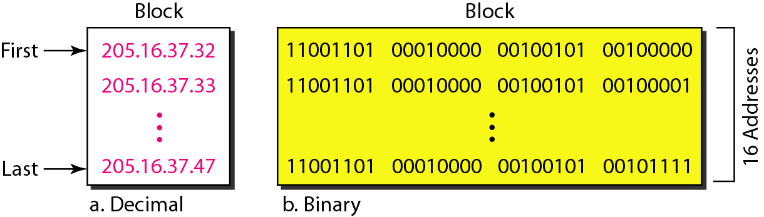
Restriction
To simplify the handling of addresses, the Internet authorities impose three restrictions on classless address blocks:
  The addresses in a block must be contiguous, one after another.
  The number of addresses in a block must be a power of 2 (1, 2, 4, 8 .... ).
  The first address must be evenly divisible by the number of addresses.

Slide 38
cntd…
The above figure shows a block of addresses, in both binary and dotted-decimal notation, granted to a small business that needs 16 addresses.
We can see that the restrictions are applied to this block.
The addresses are contiguous.
The number of addresses is a power of 2 (16 = 2⁴), and the first address is divisible by 16.
The first address, when converted to a decimal number, is 3,440,387,360, which when divided by 16 results in 215,024,210.

Slide 39
Classless addressing Mask
A better way to define a block of addresses is to select any address in the block and the mask.
As we discussed before, a mask is a 32-bit number in which the n leftmost bits are 1s and the 32 - n rightmost bits are 0s.
However, in classless addressing the mask for a block can take any value from 0 to 32.
It is very convenient to give just the value of n preceded by a slash (CIDR – Classless Inter Domain Routing notation).
The address and the /n notation completely define the whole block (the first address, the last address, and the number of addresses).

Slide 40
Method I
First address
The first address in the block can be found by setting the 32 - n rightmost bits in the binary notation of the address to 0s.
E.g. 1, A block of addresses is granted to a small organization. We know that one of the addresses is 205.16.37.39/28. What is the first address in the block?
Solution: The binary representation of the given address is
11001101 00010000 00100101 00100111
If we set 32−28 rightmost bits to 0, we get
11001101 00010000 00100101 00100000
or
205.16.37.32.

Slide 41
Last address
The last address in the block can be found by setting the 32 - n rightmost bits in the binary notation of the address to 1s.
Find the last address for the block in above E.g., 1.
Solution
The binary representation of the given address is
11001101 00010000 00100101 00100111
If we set 32 − 28 rightmost bits to 1, we get
11001101 00010000 00100101 00101111
or
205.16.37.47

Slide 42
Number of Addresses
The number of addresses in the block is the difference between the last and first address.
It can easily be found using the formula 2^{32-n}.
Example
Find the number of addresses in E.g., 1.
Solution
The value of n is 28, which means that number of addresses is 2 ³²⁻²⁸ or 16

Slide 43
Method II
Another way to find the first address, the last address, and the number of addresses is to represent the mask as a 32-bit binary (or 8-digit hexadecimal) number.
  This is particularly useful when we are writing a program to find these pieces of information.
  In the above example the /28 can be represented as:
  11111111 11111111 11111111 11110000 (twenty-eight 1s and four 0s).
Find
  The first address
  The last address
  The number of addresses.

Slide 44
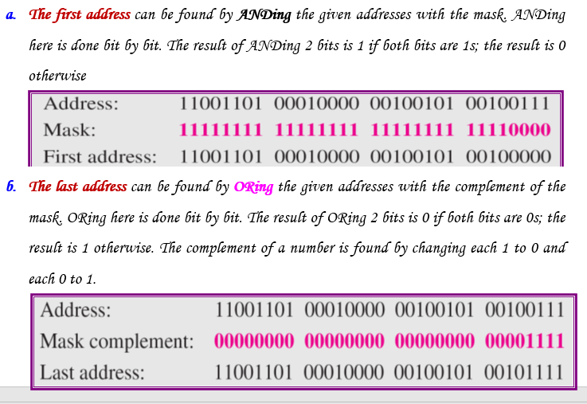
Cntd…

Slide 45
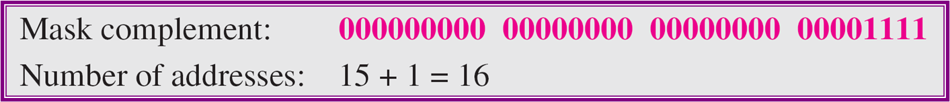
Cntd…
The number of addresses can be found by complementing the mask, interpreting it as a decimal number, and adding 1 to it.

Slide 46
Address Allocation
The next issue in classless addressing is address allocation. How are the blocks allocated?
The ultimate responsibility of address allocation is given to a global authority called the Internet Corporation for Assigned Names and Addresses (ICANN).
However, ICANN does not normally allocate addresses to individual organizations.
It assigns a large block of addresses to an ISP.
Each ISP, in turn, divides its assigned block into smaller sub blocks and grants the sub blocks to its customers.
In other words, an ISP receives one large block to be distributed to its Internet users. This is called address aggregation: many blocks of addresses are aggregated in one block and granted to one ISP.

Slide 47
Example
An ISP is granted a block of addresses starting with 190.100.0.0/16 (65,536 addresses).
The ISP needs to distribute these addresses to three groups of customers as follows:
  The first group has 64 customers; each needs 256 addresses.
  The second group has 128 customers; each needs 128 addresses.
  The third group has 128 customers; each needs 64 addresses.
Q: Design the sub blocks and find out how many addresses are still available after these allocations?

Slide 48
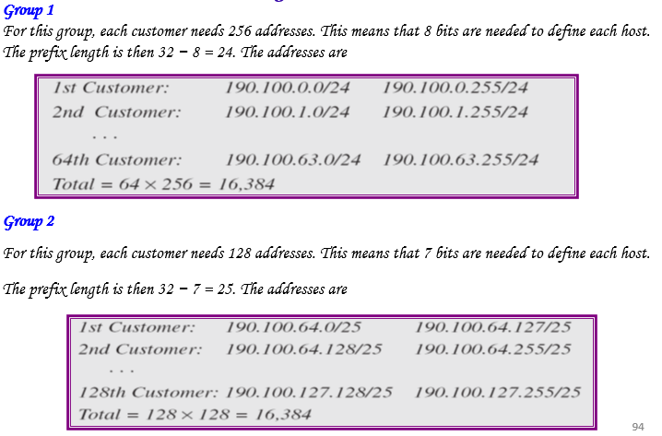
Solution

Slide 49
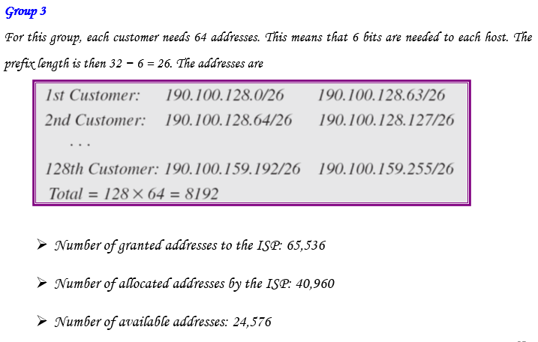
Solution

Slide 50
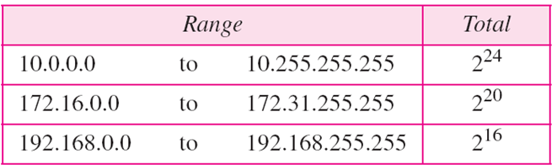
Network Address Translation (NAT)
Many users start to have more hosts to be connected to the internet
IP addresses are in depletion
Solution: NAT
NAT enables a user to have a large set of addresses internally and one address, or a small set of addresses, externally.
The traffic inside can use the large set; the traffic outside, the small set.
Reading Assignment
Read how NAT works, Investigate the global IP address scheme of AMU and how they use it in NAT

Slide 51
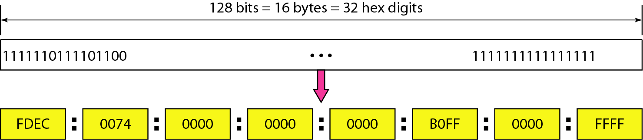
IPv6 Addresses
Internet Protocol (IP) version 4 is the most commonly used communication protocol for both the Internet and internal network environments.
  Although IPv4 is robust and scalable, new technologies and higher demand have paved the way for the eventual adoption of IPv6.
Despite all short-term solutions, address depletion is still a long-term problem for the Internet.
  This and other problems in the IP protocol itself have been the motivation for IPv6.
An IPv6 address is 128 bits or 32 hexadecimal digits long.

Slide 52
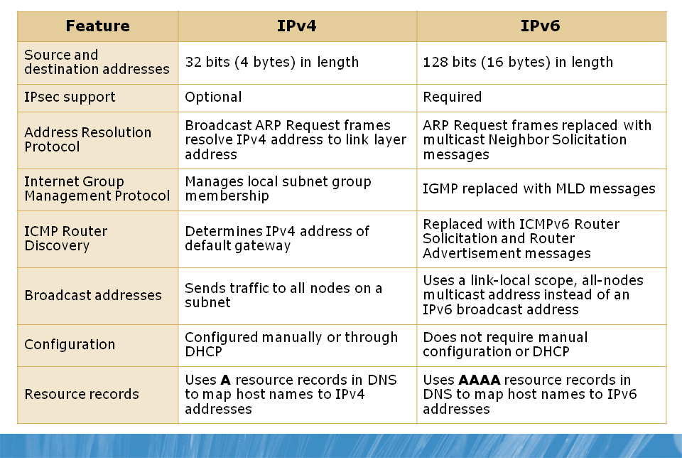
Differences Between IPv4 and IPv6
Notes:
Multicast listener discovery

Slide 53
Advantages of IPv6 Addressing Scheme
Large address space:- IPv6 uses a 128-bit address space, which allows for 3.4x10³⁸ or 340,282,366,920,938,463,463,374,607,431,768,211,456 possible addresses.
Hierarchical addressing and routing infrastructure:- The IPv6 address space is designed to be more efficient for routers, which means that even though there are many more addresses, routers can process data much more efficiently because of address optimization.
Stateless and Stateful address configuration:- Stateless address configuration refers to host IP configuration without a DHCP server.
  Stateful address configuration refers to host IP configuration that uses a DHCP server.
  IPv6 supports both stateless and stateful address configuration.
  With stateless address configuration, hosts automatically configure themselves with IPv6 link-local addresses along with additional addresses advertised by local routers.

Slide 54
Cntd…
Built-in security:- IPv6 has built-in IP security, which facilitates configuration of secure network connections.
Prioritized delivery:- IPv6 contains a field in the packet that allows network devices to determine the specified rate at which the packet should be processed.
  This allows traffic prioritization or QoS. For example, when streaming video traffic, it is critical that the packets arrive in a timely manner. You can set this field to ensure that network devices determine that the packet delivery is time-sensitive.
Neighbor detection:- IPv6 uses the Neighbor Discovery protocol to manage the interaction between nodes within the same network link.
  Neighbor Discovery replaces the broadcast-based Address Resolution Protocol (ARP) with more efficient multicast and unicast communication within the same network segment.
Extensibility:- IPv6 has been designed so that it can be extended with fewer constraints than IPv4.

Slide 55
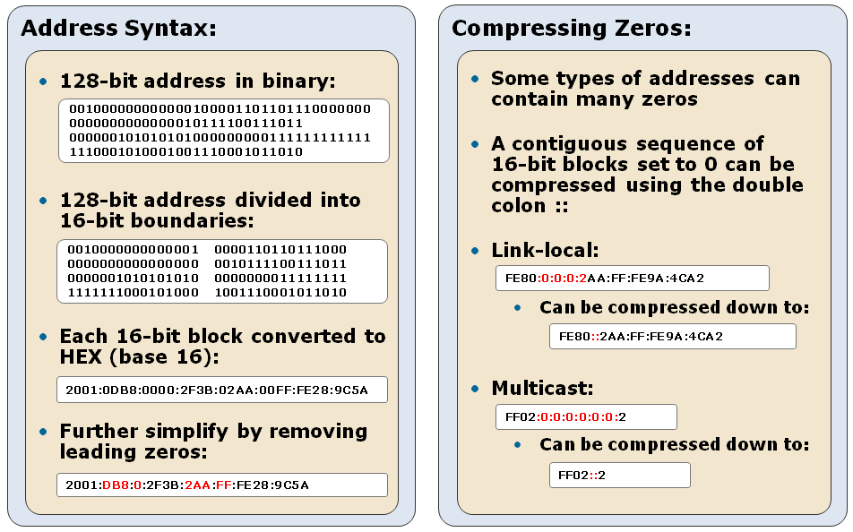
IPv6 Address Space

Slide 56
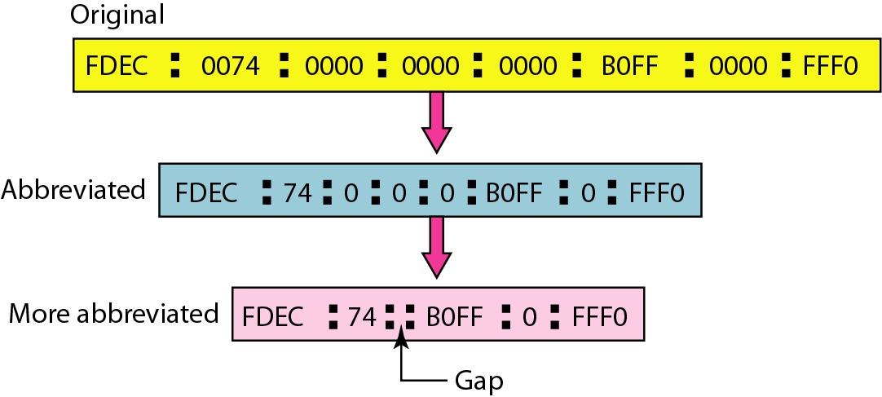
Abbreviated IPv6 addresses

Slide 57
Example
Expand the address 0:15::1:12:1213 to its original.
Solution
We first need to align the left side of the double colon to the left of the original pattern and the right side of the double colon to the right of the original pattern to find how many 0s we need to replace the double colon.
  This means the original address is:

Slide 58
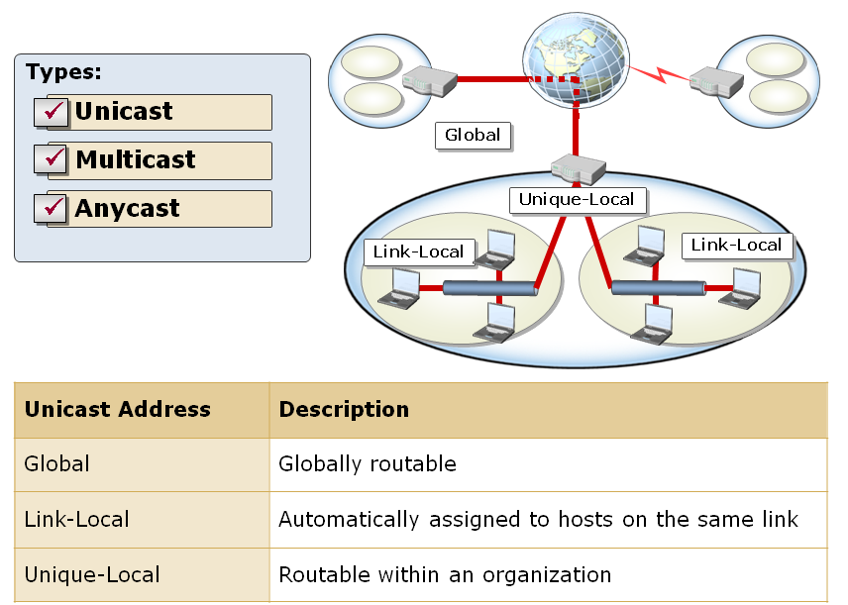
Types of IPv6 Addresses

Slide 59
Cntd…
  There are three main types of IPv6 addresses:
  Unicast:- Identifies a single interface within the address scope.
  Packets that are addressed to this address are delivered to a single interface.
  Multicast:- Identifies multiple interfaces and delivers packets to all interfaces that are identified by the address.
  It is used for one-to-many communication over a network infrastructure.
  Anycast:- Identifies multiple interfaces, but delivers packets to the nearest interface.
  It is used for one-to-many communication, with delivery to a single interface.

Slide 60
  End of Chapter Three
  Any question ???

